Slide 1
Parallel projects status monitoring for Engineering operation created with Python Pandas/mySQL/Brity RPA
Terry Lee

Slide 2
Disclaimer
This file does not contain any sensitive corporate data, specific process details, or information pertaining to any particular organization or individuals. Its purpose is to offer a high-level view of the generic steps taken by the authors to address a specific business problem. It serves as a scalable and adaptable template, enabling the replication of these steps for solving similar problems in future. Additionally, it includes technical details that can be partially or entirely reused for ongoing learning and improvement in future projects.

Slide 3
Business problem: A global manufacturing firm has hundreds of on going maintenance software delivery projects for significant number of products in market. The projects are concurrently rolled out to entire globe and dealing with multiple client operators for each country makes it hard to develop a unified centralized system to handle all localized needs of tracking for specific regions. Australian team found that it is extremely difficult to sync up the milestones of each step in the 200+ projects from software releases, testing status in the field, client interoperability testing and approval, to delivery to end customer via over the air update. There is no R&D budget to build a system to meet such needs for regional subsidiaries.
Solution: Each stage in the milestone can be modularized and treated as small project, continuously improved on its own. Pulling up the relevant data from system can be achieved using unattended scheduled run of Robotic Process Automation on a daily basis. The pulled data for each module can be cleaned and analysed using Python pandas, and SQL (mySQL or postgreSQL) for further analysis and storage. For interactions with clients or offshore teams communications where no specific systems are available, data from emails can be extracted with regex and transformed into structured data sets using Python API on outlook. The status tracking data for entire product lines is now available and can be shared in excel table uploaded in SharePoint for team review meeting, can be checked-in/out for manual adjustments when needed.

Slide 4
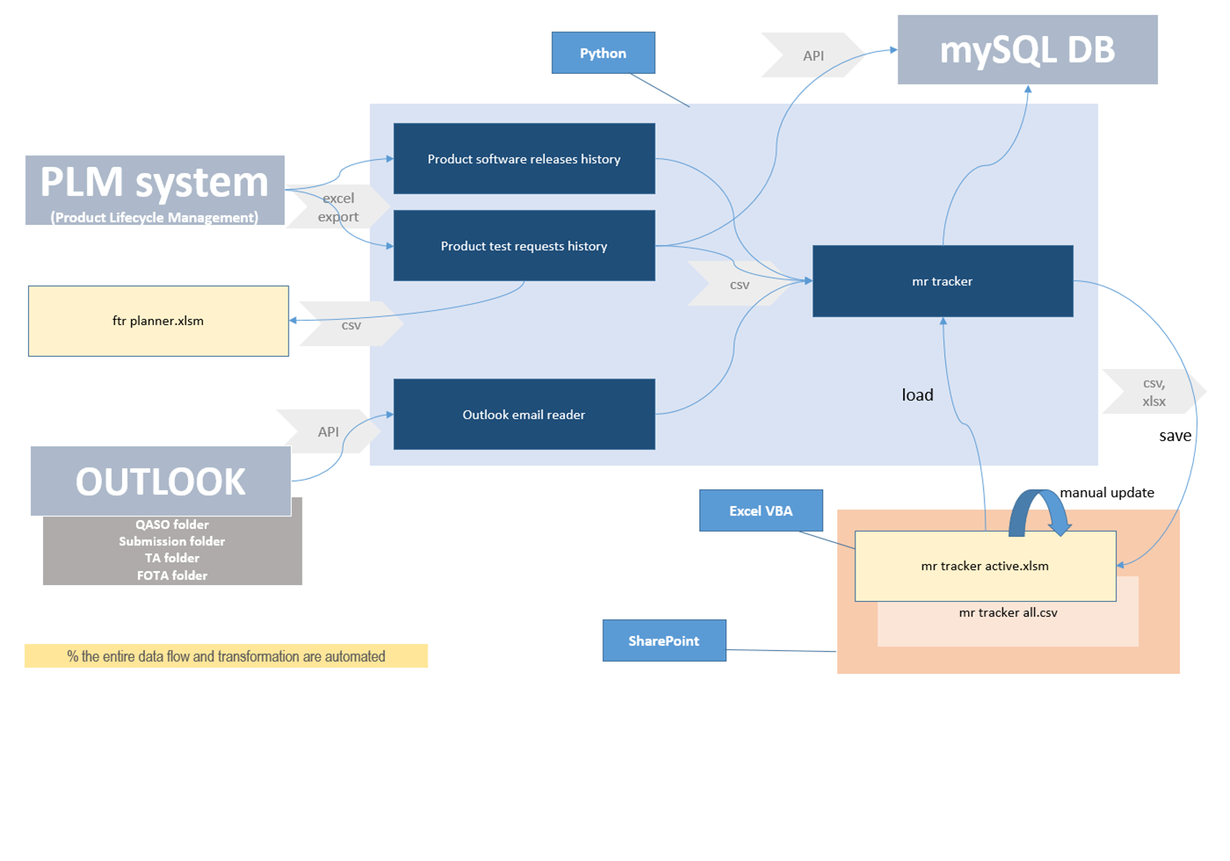
RPA
Pandas library

